Slide 1
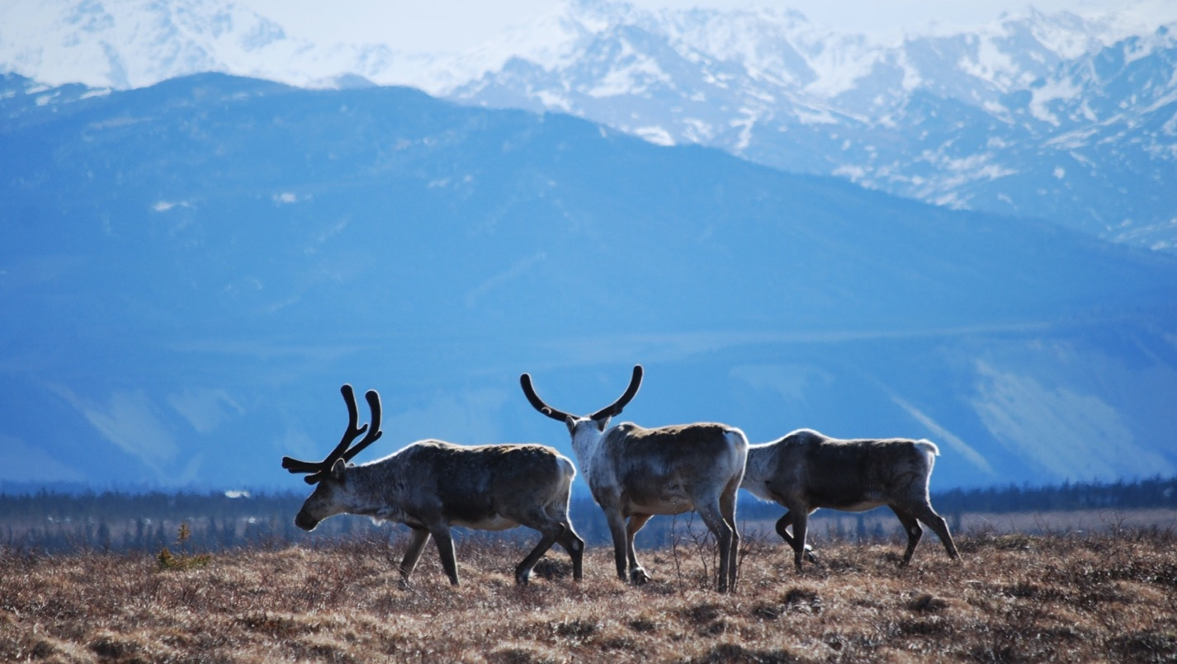
Arctic Boreal Vulnerability Experiment (ABoVE)
2019 ABoVE Airborne Flights
12 July 2019 (DOY 193)
AVIRIS-NG: Ivotuk – Barrow – Atqasuk
Charles Miller, Deputy Science Lead
Jet Propulsion Laboratory, California Institute of Technology
and the ABoVE Science Team For Hank Margolis, Mike Falkowski, Bruce Tagg, Jack Kaye
NASA HQ
2019

Slide 2
12 July 2019/DOY 193 Ivotuk – Barrow – Atqasuk
Daily Status:
AVIRIS-NG / Dynamic Aviation B-200 (N53W)
REPORT DATE: 12 July 2019
Current Status of Aircraft: GREEN
Current Status of AVIRIS: GREEN
Current Deployment Location: Fairbanks AK (PAFA)
Crew: M Drowley (PIC), C McCann, M Helmlinger, J Chapman
Science Planning: A Thorpe
Data Processing: W Olsen-Duvall
Instrument Manager: M Eastwood
Instrument PI: R Green
Science Lead: C Miller

Slide 3
12 July 2019/DOY 193 Ivotuk – Barrow – Atqasuk
Daily Summary:
Mostly clear with some high cirrus
Coastal fog and low clouds absent
NEON AOP also operating at Barrow today
Update

Slide 4
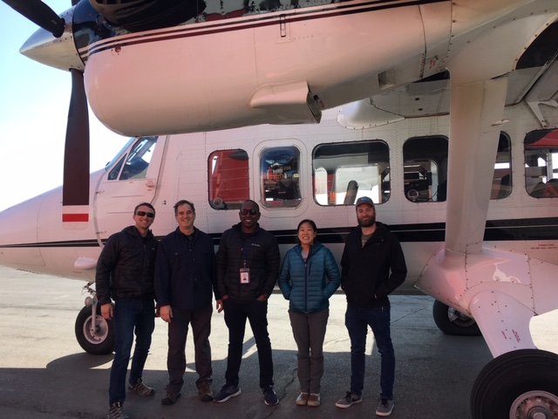
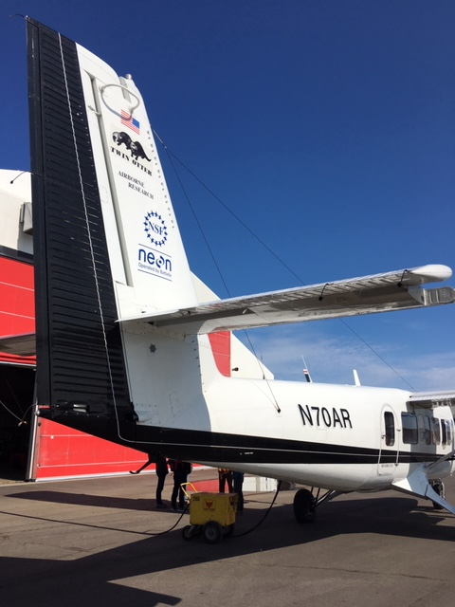
12 July 2019/DOY 193 Ivotuk – Barrow – Atqasuk
Update
Notes:
AVIRIS & NEON teams in Barrow

Slide 5
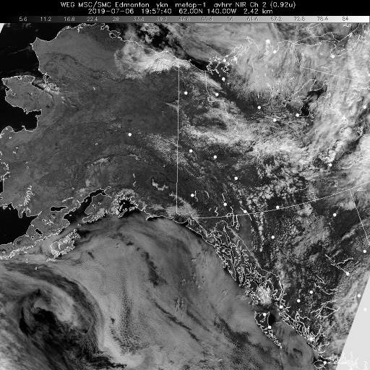
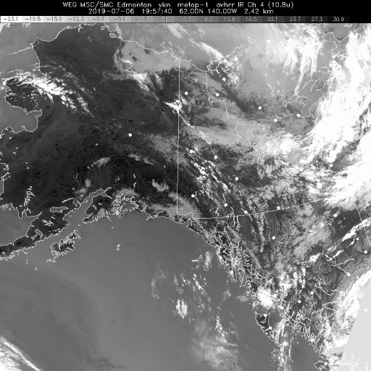
12 July 2019/DOY 193 Ivotuk – Barrow – Atqasuk
Vis 1957Z
IR 1957Z
Notes:
Some high cirrus, but no low level couds along the Ivotuk – Atqasuk – Barrow corridor. No coastal fog!

Slide 6
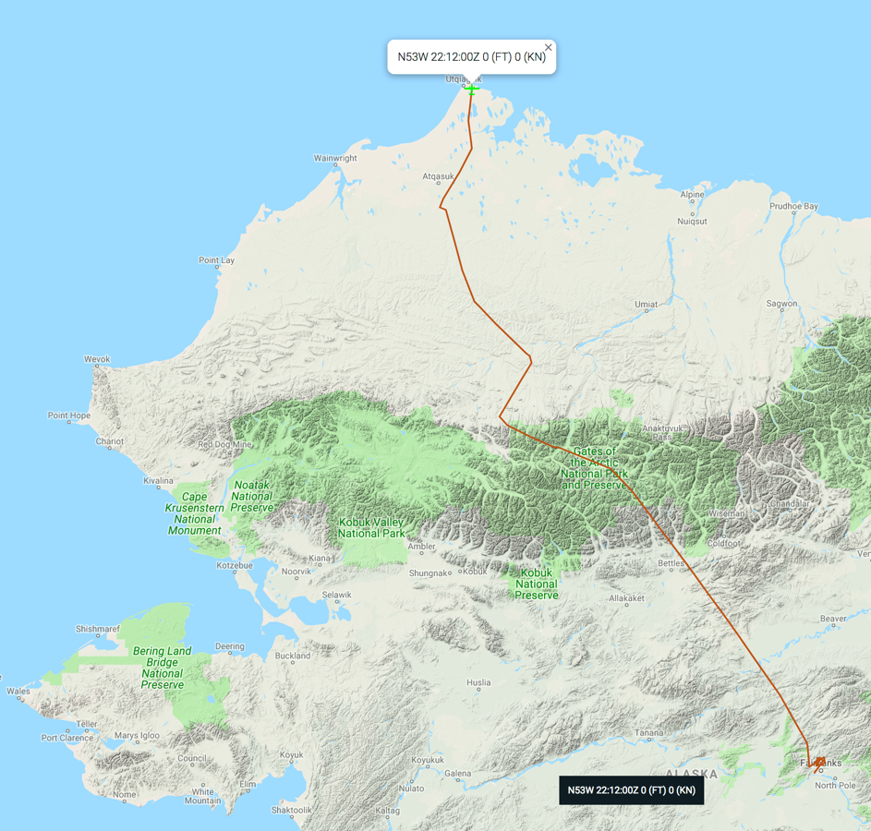
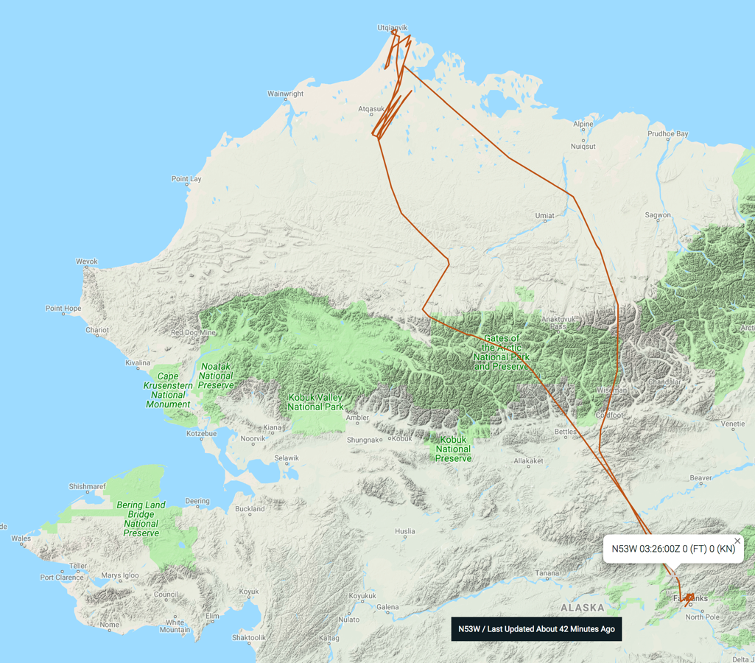
12 July 2019/DOY 193 Ivotuk – Barrow – Atqasuk
Leg 1
Leg 2
Update
As-Flown Lines

Slide 7
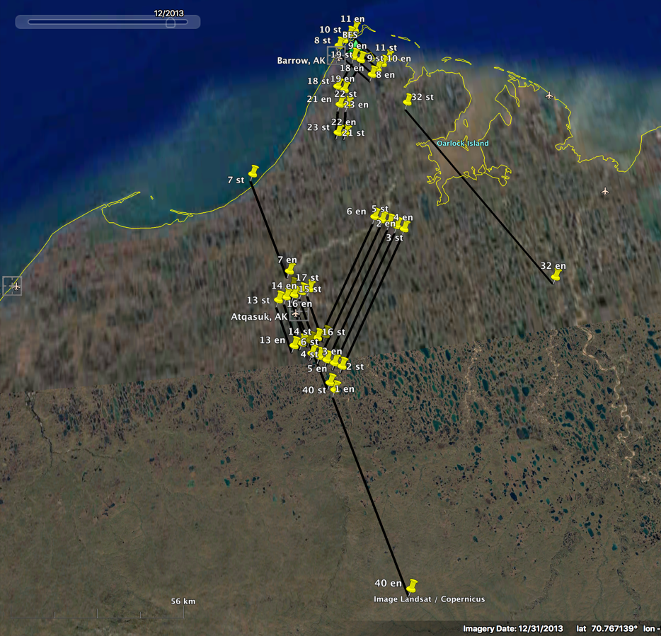
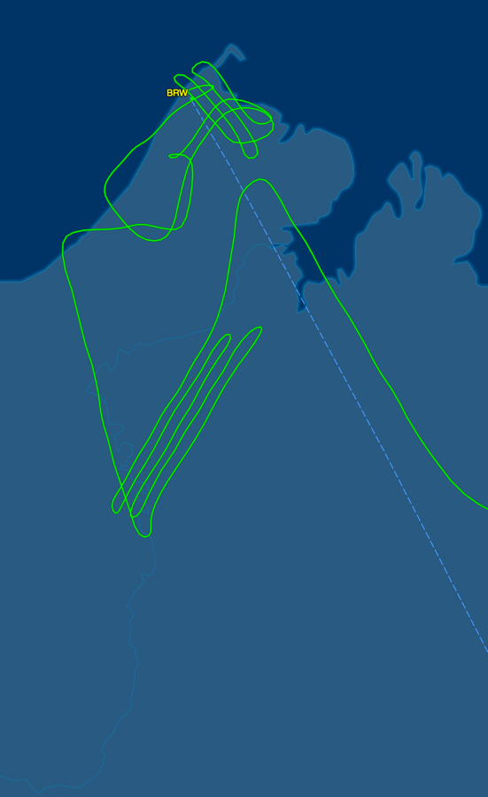
12 July 2019/DOY 193 Ivotuk – Barrow – Atqasuk
Update
Barrow - Atqasuk Area
Planned Flight Lines
Barrow - Atqasuk Area
As-Flown Lines

Slide 8
12 July 2019/DOY 193 Ivotuk – Barrow – Atqasuk
AVIRIS-NG Quick-look products
https://avirisng.jpl.nasa.gov/cgi/flights.cgi?step=view_flightlog&flight_id=ang20180721t
A. Line 325A-D, FL183, Run ID 183446: Chalkyitsik – Porcupine River
B. Line 325A-D, FL183, Run ID 201426 : Chalkyitsik – Porcupine River - reverse
A
Update
B
A. A bit of fogging on lower edge of image
B. Popcorn clouds and orthorectification glitch near left edge

Slide 9
Backup

Slide 10
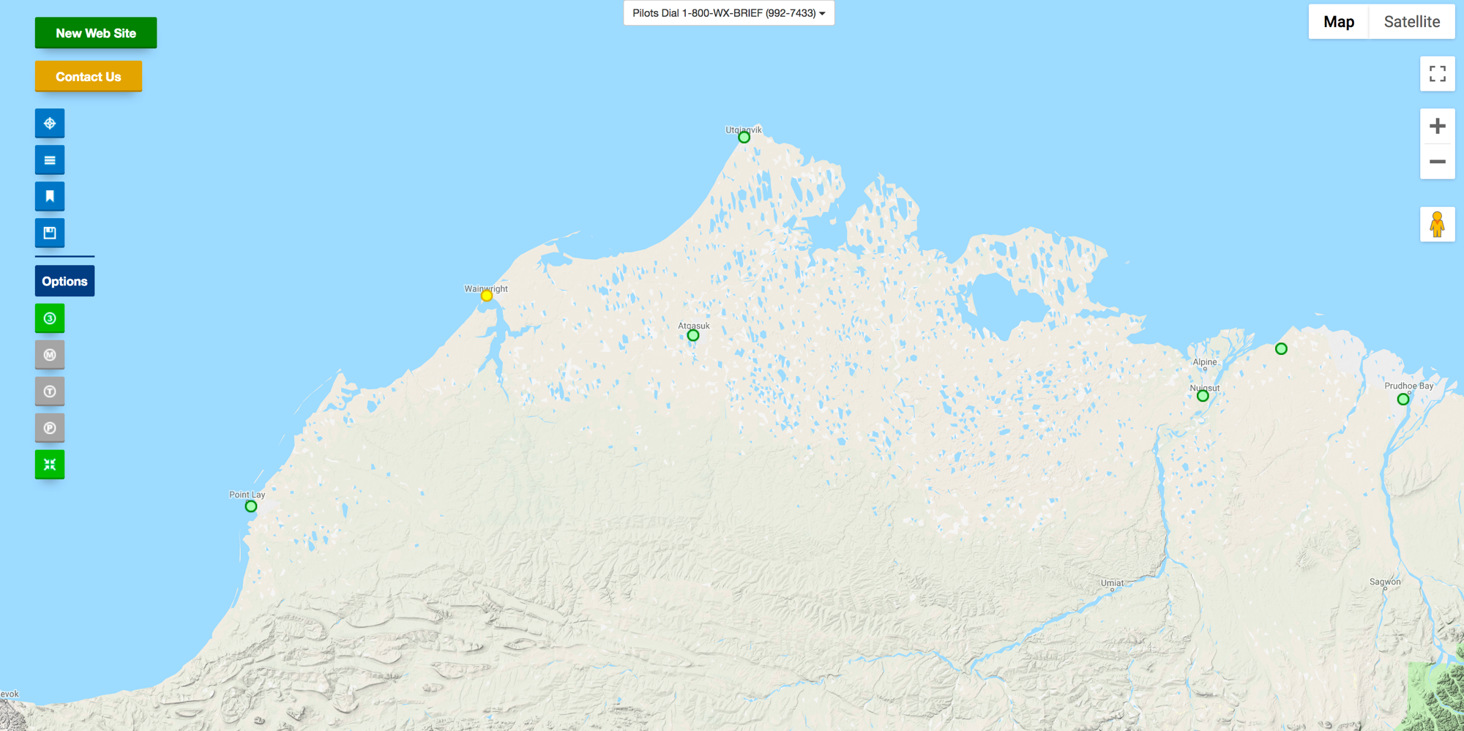
FAA Camera Locations

Slide 11
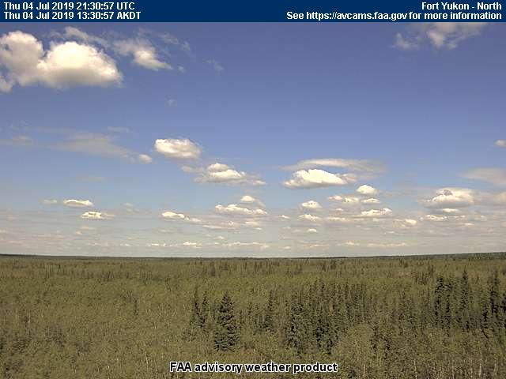
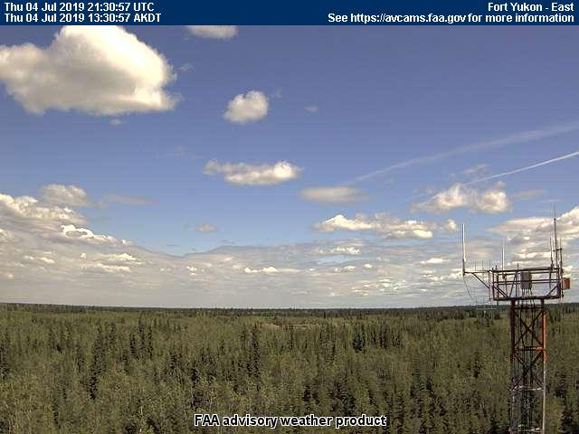
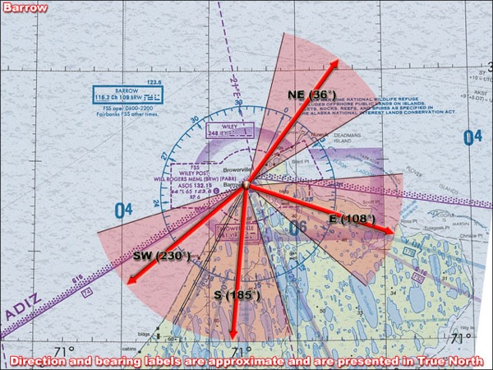
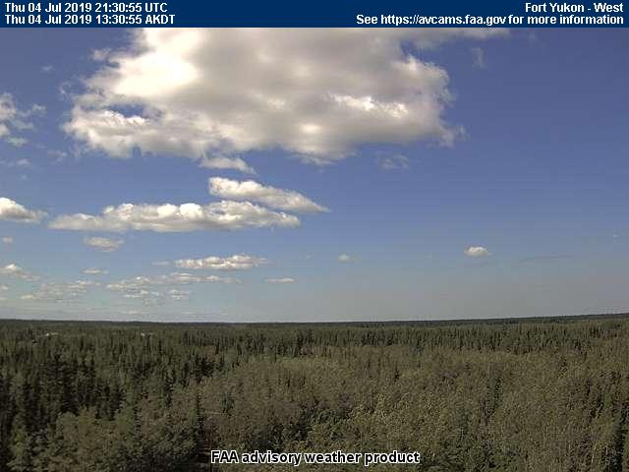
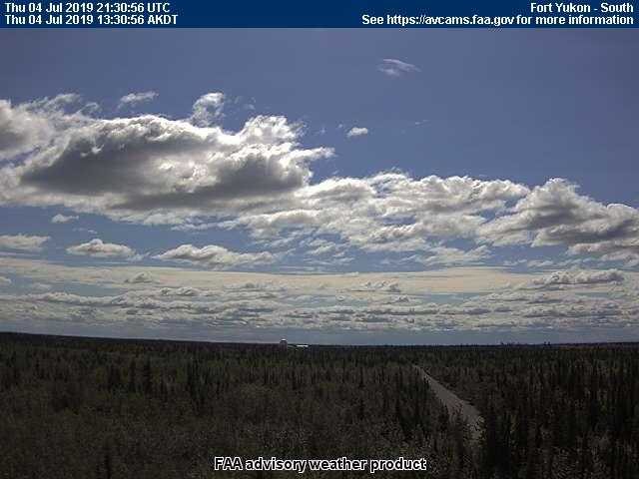
12 July 2019/DOY 193 Ivotuk – Barrow – Atqasuk
Update
Barrow – 1330 AKDT/2130 UTC
Northeast
East
Southwest
South

Slide 12
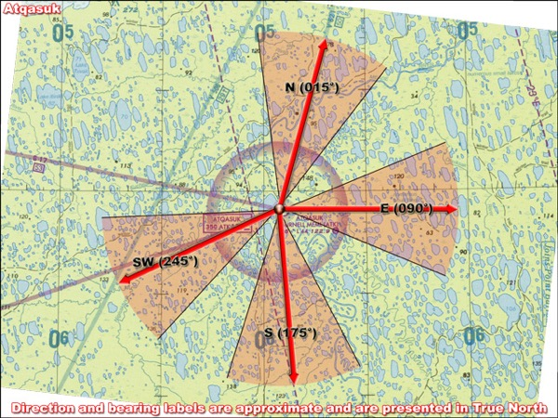
12 July 2019/DOY 193 Ivotuk – Barrow – Atqasuk
Update
Atqasuk – 1330 AKDT/2130 UTC
North
East
Southwest
South

Slide 13
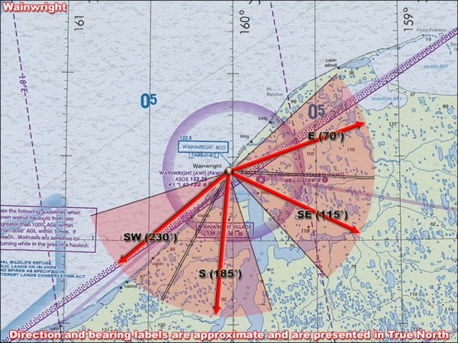
12 July 2019/DOY 193 Ivotuk – Barrow – Atqasuk
Update
Wainwright – 1330 AKDT/2130 UTC
East
Southeast
Southwest
South

